Slide 1


Steel Industry Energy Consumption
In a smart small-scale steel industry in South Korea
Vithushan Vadivel
SEP 23rd | PARIS
DAFT JUL25

Slide 2


Business case
Energy Consumptions in small scale industry in South Korea
A set of Data inorder to predict the consumption of energy in daily, weekly, monthly and annually
Is there any correlations in between the factors related to the energy consumptions?
Yes, Lagging Current reactive power Continuous is highly correlated in energy consumptions

Slide 3
Plan
main methods and ideas
Investigation of my business case
Look for data related to my business case
Data collection
Data cleaning and exploratory data analysis
Decide on database type
Build my ERD Model
Creation of database and data importation
Write queries for insights
Modeling
Conclusions

Slide 4
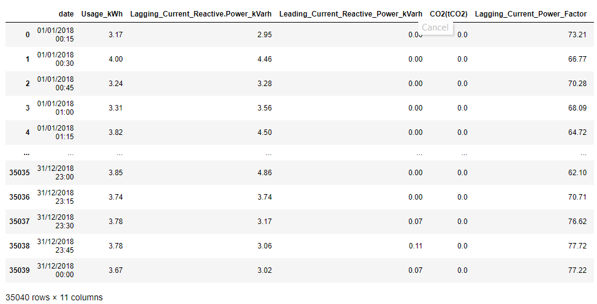
About data
Daily recorded usage , Lagging Current reactive power, tCO2(CO2, Load Type, Week Status, Day of week are available every 15 minutes from the beginning of day of January 1st to 31st December 2018.
displays daily usage , current reactive power, co2 emission data every 15 minutes in the year 2018
Presents comparable data set from January 1st to 31st December 2018 and time slot
(pccs.kepco.go.kr)
Notes:
created by the University of Dayton - Environmental Protection Agency, stored in their Average Daily Temperature Archive, source university American National Climatic Data Center
first data source: Climate Watch. created 2018 by a Washington DC based institution named: World Resources Institute, Climate Watch offers open data, visualizations and analysis to help policymakers, researchers and other stakeholders gather insights on countries' climate progress.
The PRIMAP-hist national historical emissions time series (1850-2014). V. 1.1, collected and created by Gtschow Johannes, Jeffery Louise, Gieseke Robert and Gebel Ronja in 2017 as part of the potsdom institute for climat impact research
UNFCCC data: Greenhouse Gas Inventory Data - Detailed data by Party created by UNFCCC in 2017, released by the United Nations climat change institut
The World Resources Institute is a global research non-profit organization established in 1982 with funding from the MacArthur Foundation under the leadership of James Gustave Speth. WRI's activities are focused on seven areas: food, forests, water, energy, cities, climate and ocean.

Slide 5
Data collection
Notes:
.datset2 → All of the numeric data is given in Metric tons of carbon dioxide equivalent or MTCO2e.

Slide 6
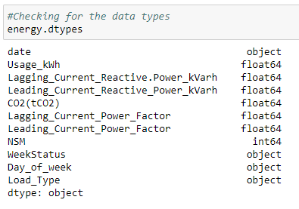
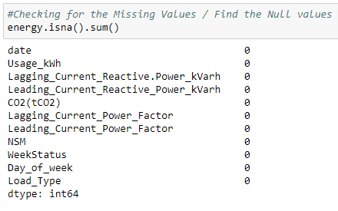
Data cleaning
Importing necessary libraries
Importing Data by reading csv file by pandas
Initialization of Data Cleaning Process
Checking .info(), .shape() to get more details of the data.
Checking column names to verify whether there is a unwanted space or not and changed to the common name structure.
Checking data types(.dtypes) whether they are in the correct data variables
2. Checking and dealing with missing values
3. Getting exploratory analysis and dealing with outliers by using .describe() function

Slide 7
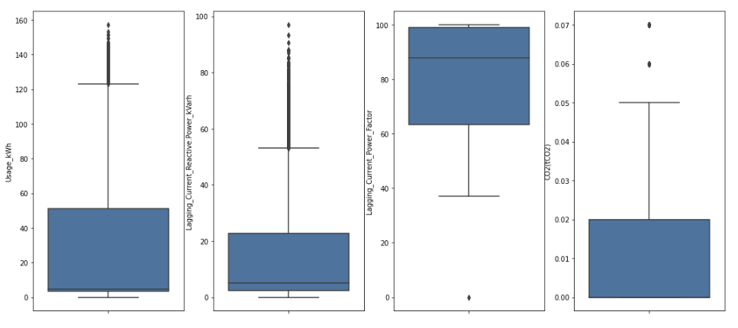
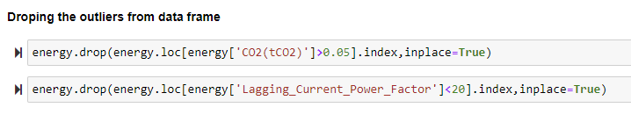
Data cleaning
Checking Ouliers using boxplots for each numerical columns and removing the outliers using drop functions

Slide 8
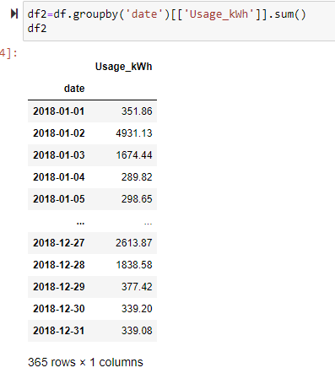
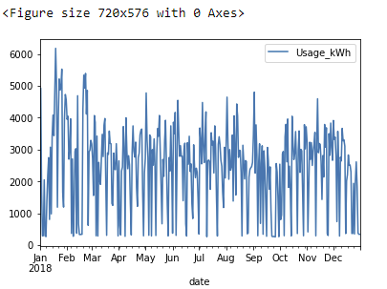
Exploratory Data analysis

Slide 9
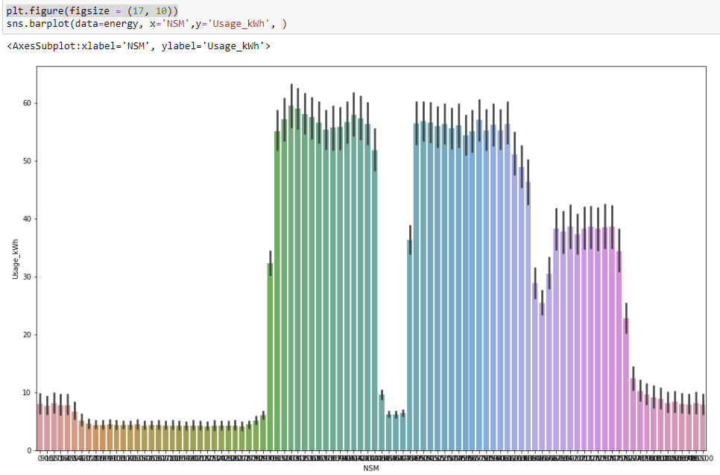
Exploratory Data analysis
Barplot to show the usage of power changes by every 15 minutes in the whole year 2018

Slide 10
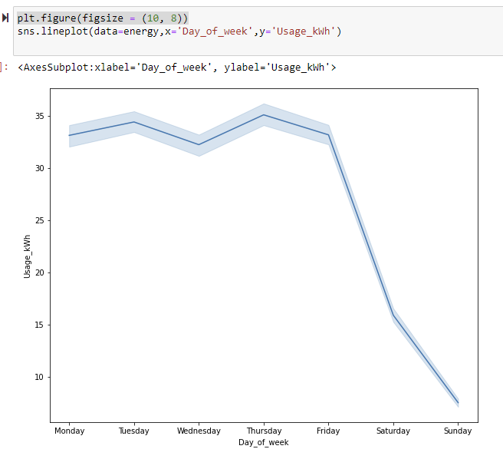
Exploratory Data analysis
Line graph to analyse the changes of usage of power/energy in a week

Slide 11
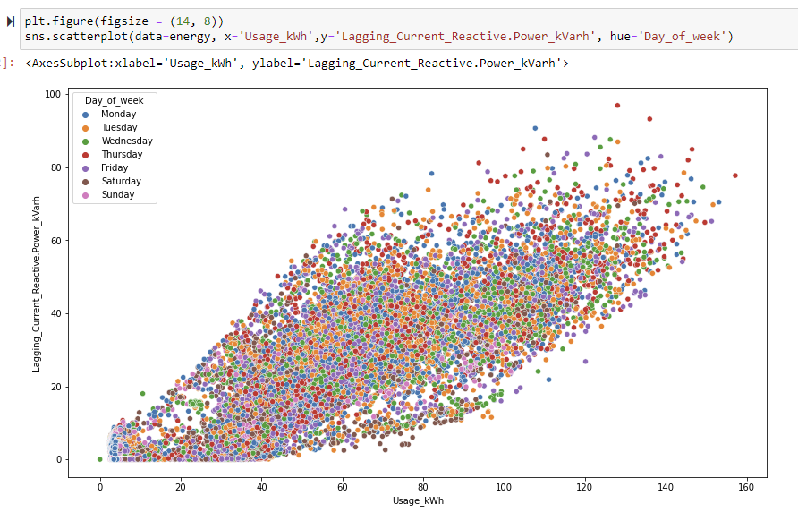
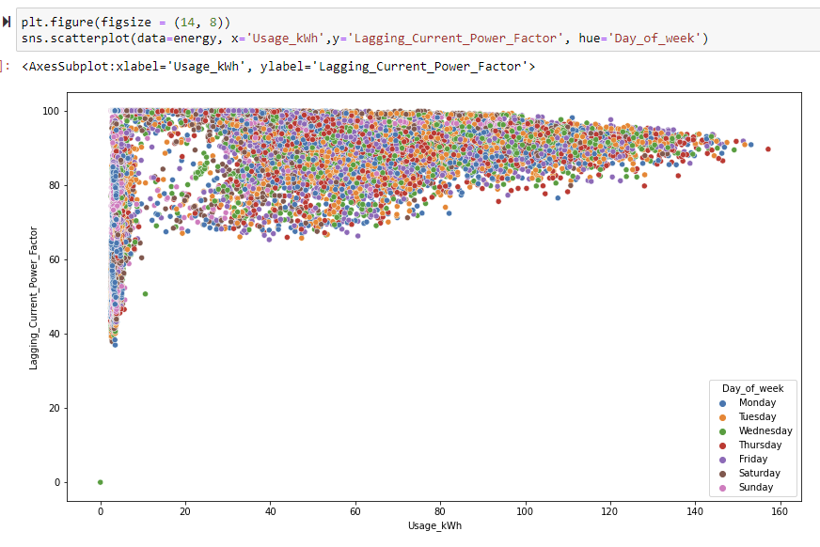
Exploratory Data analysis
Scatterplot to show the correlations in between Usage of energy and Lagging current reactive power and Lagging current power factor

Slide 12

Data base comparison
I decided to use a SQL database
allows me to use my cleaned and converted data frames
perform queries on a small level.
link the different tables with each on their relational basis.
do not care about object-oriented programming
writing longer queries is acceptable
The most important factor is to be able to work with the output of my data cleaning process: structured data
The relational database I will use is MySQL
Notes:
Centralized: stores data at a centralized database system + access from different locations + authentication process Distributed: distributed among different database systems + database systems are connected via communication links Relational: based on the relational data model + which stores data in the form of a table (row +column) + uses SQL for storing, manipulating Object-oriented: uses the object-based data model approach for storing data Why SQL: ability to store the data collected + ability to create queries and retrieve information + ability to create relations or not

Slide 13
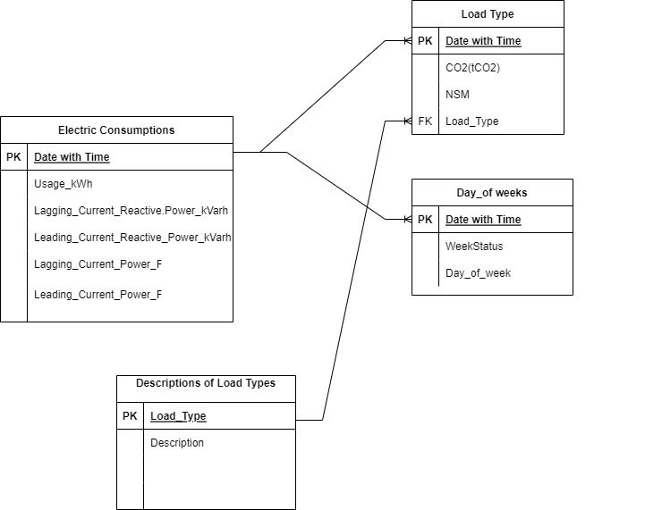
ERD
Electric consumption entity: Date with Time is the primary key and it has the other factors which influence in the consumptions of electrical energy
Load Type entity : Here also Date with Time is the primary key and it has the features of emission of CO2 number of seconds from midnight, load types
Day of week entity: here also Date with Time is the primary key and it has week status and day of week
Descriptions of load type entity: Load Type is the primary
key and it has just descriptions

Slide 14
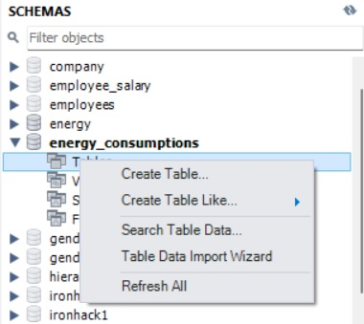
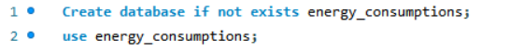
Database creation
As because the data is huge, all entity is imported through table data import wizard.

Slide 15
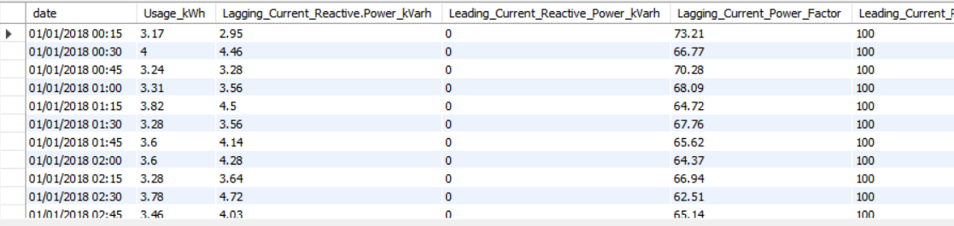
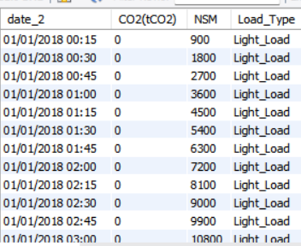
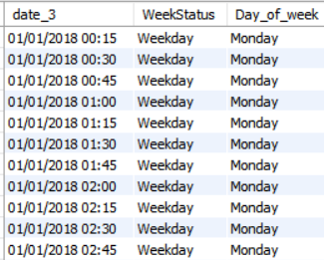
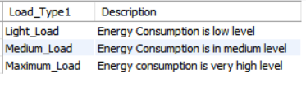
Tables

Slide 16
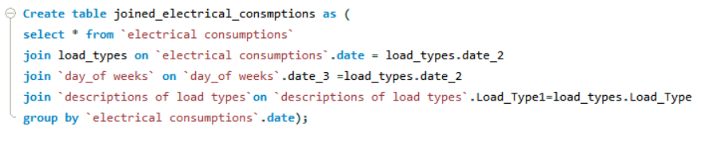
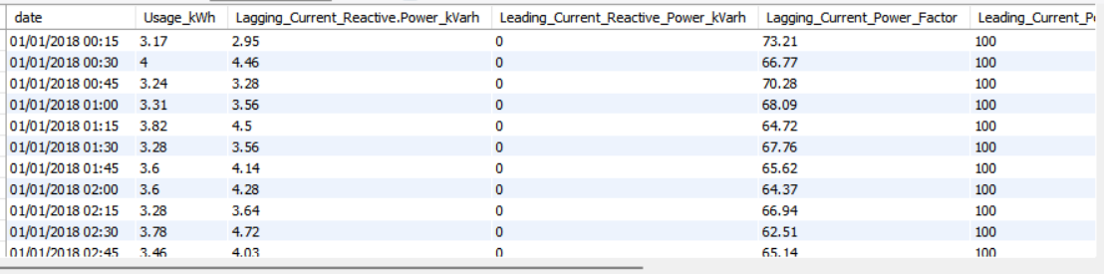
Joining Entities into one table using Primary keys and Foreign keys

Slide 17
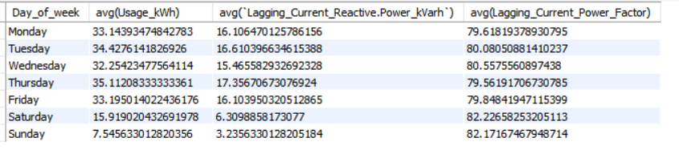
Insight queries
checking the average use of electricity in week days is approximately same and less amount of energy is used in weekends.

Slide 18
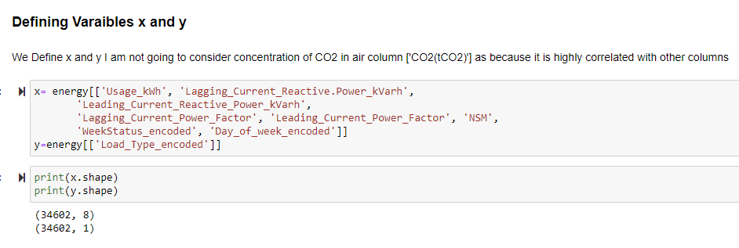
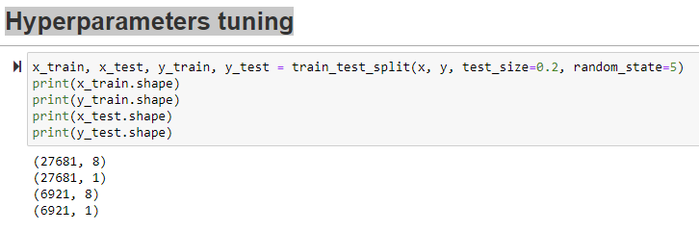
Supervised Learning
Hyperparameters tuning

Slide 19
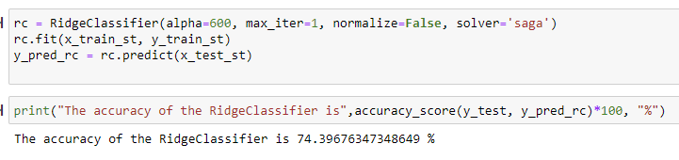
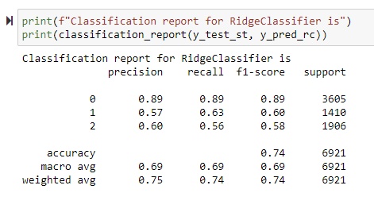
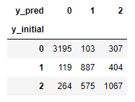
RidgeClassifier – Model Testing
Notes:
Solar hydro and

Slide 20
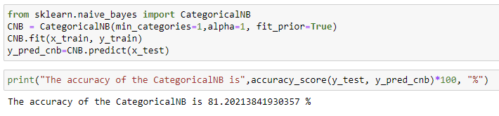
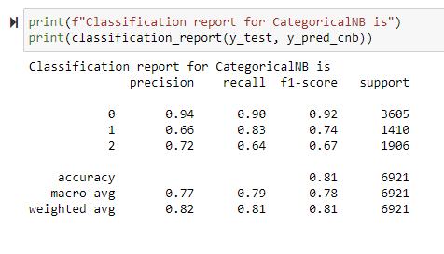
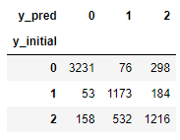
CategoricalNB - Model Testing

Slide 21
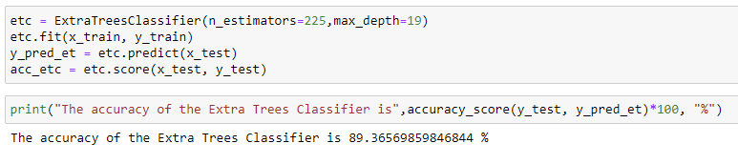
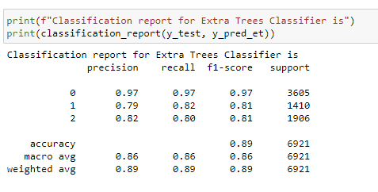
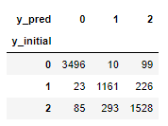
Extra Trees Classifier - Model Testing

Slide 22
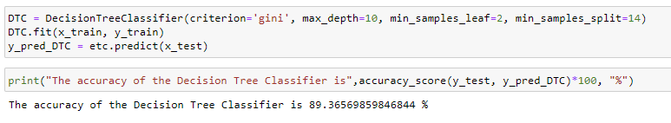
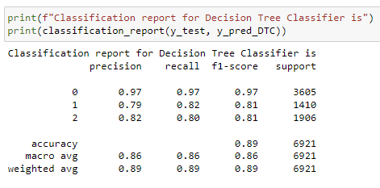
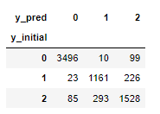
DecisionTreeClassifier - Model Testing

Slide 23
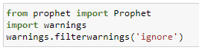
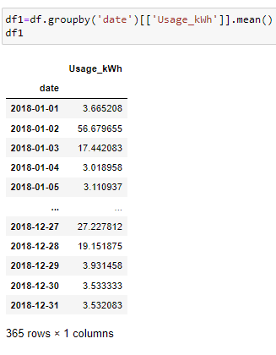
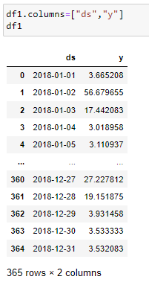
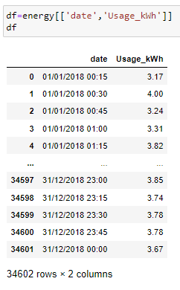
Forecasting Timeseries using Prophet
Forecasted consumption of energy for the year 2019 by using prophet library in python

Slide 24
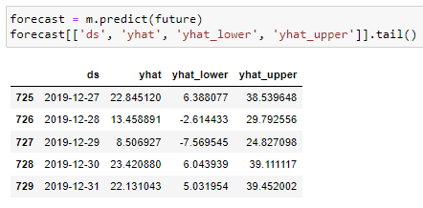
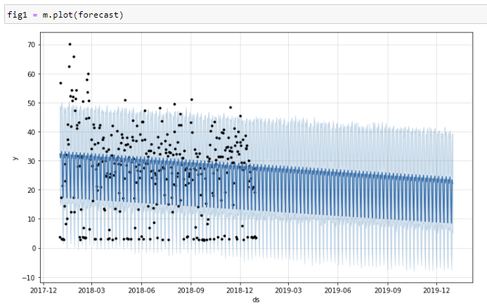
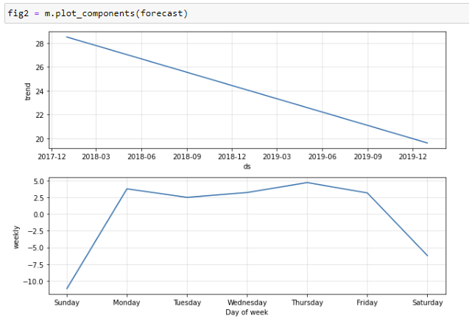
Forecasting Timeseries using Prophet

Slide 25
Conclusions
Notes:
For example the fact that over 150 cities recorded in the data were based in the US might have affected the output of my analysis regarding the general temperature increase over the years. If I would have had more time, further steps could have been taking into account more data measurements about different countries so there would be an equal amount of data for each country proportionally.

Slide 26
Questions?

